Slide 1
Harnessing Flexible and Reliable Demand Response Under Customer Uncertainties
Joshua Comden, Zhenhua Liu, Yue Zhao
Stony Brook University
ACM eEnergy 2017

Slide 2
Solar + Wind energy outpaces DR adoption
California State Legislature solution (2013):
1,325 MW of grid storage by 2020
Expensive
http://energyalmanac.ca.gov/electricity/electric_generation_capacity.html
FERC Assessment of Demand Response and Advanced Metering Staff Reports: 2010-2015.
CAISO Demand Response Barriers Study 2009.
Notes:
As we know Solar and Wind generation is increasing rapidly, however Demand Response is not. ……The gap may widen if actions are not taken … Also using batteries for storage may not be environmentally friendly.

Slide 3
Approaches to integrate renewables
Supply-side
Distributed Rate Control for Smart Solar Arrays
S. Lee , S. Iyengar , D. Irwin , P. Shenoy
Demand-side
Energy Storage:
Crowd-Sourced Storage-Assisted Demand Response in Microgrids
M. Hajiesmaili, M. Chen, E. Mallada, Chi-Kin Chau
Incentive Programs:
EnergyCoupon: A Case Study on Incentive-based Demand Response in Smart Grid
B. Xia, H. Ming, K. Lee, Y. Li, Y. Zhou, S. Bansal, S. Shakkottai, L. Xie
Generation and Evaluation of Flex-Offers from Flexible Devices
B. Neupane, L. Siksnys, T.B. Pedersen
Our Approach

Slide 4
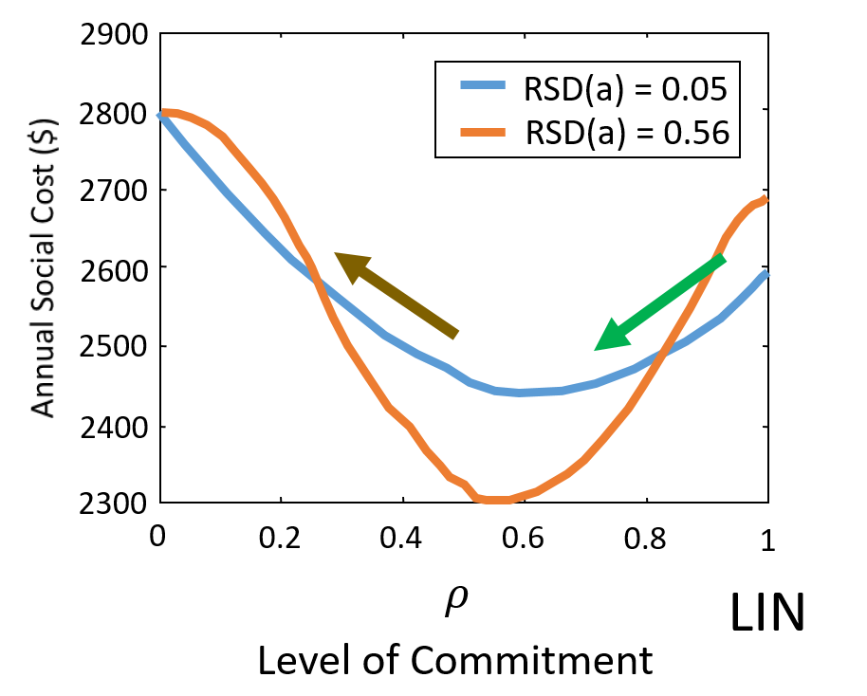
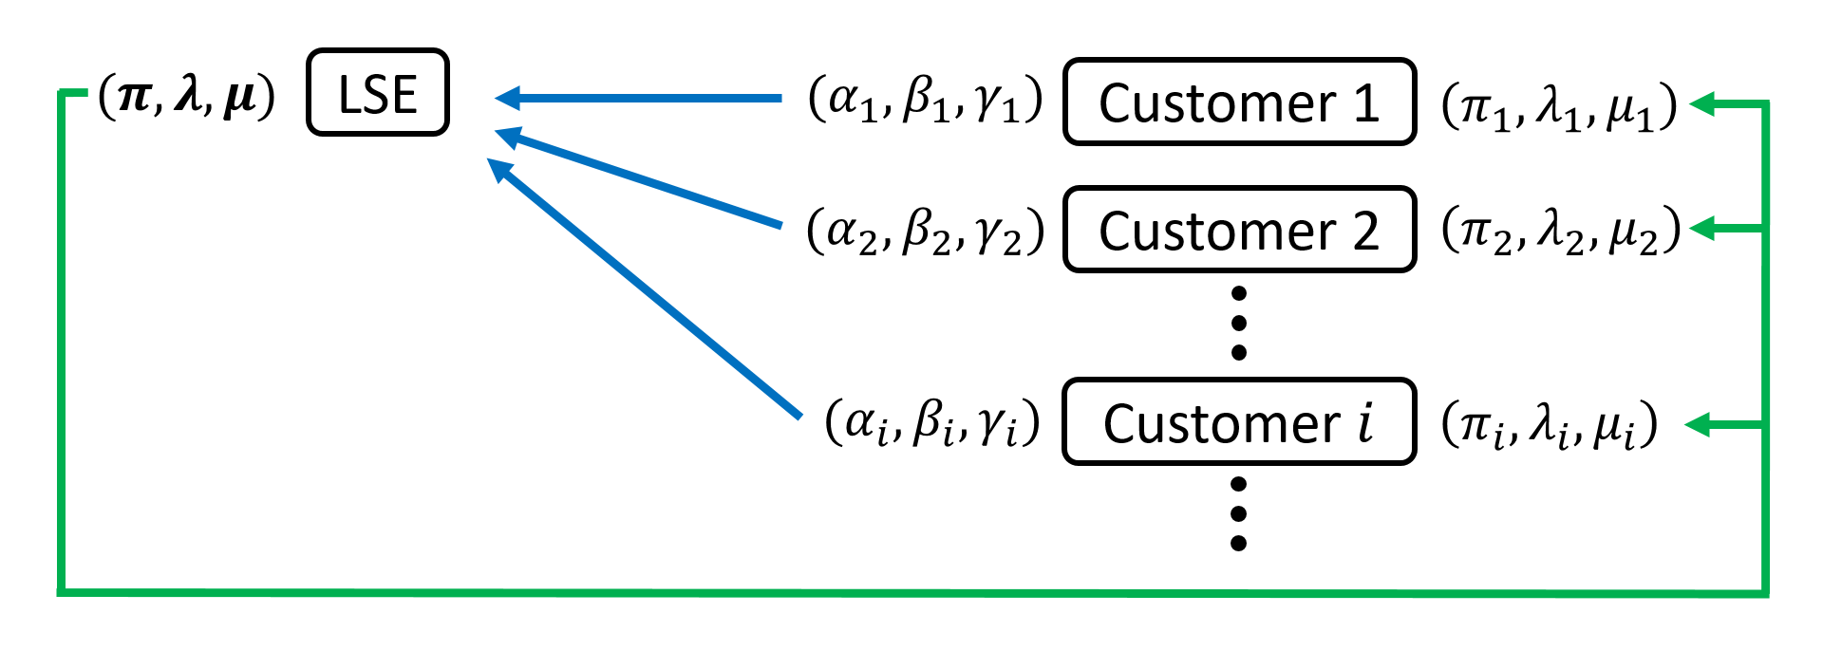
Goal: Increase reliable DR adoption
Approach: Incorporate Customer Uncertainties
Distributed Algorithm
Leverage Randomness
Notes:
FCDR will optimize the Level of Commitment.

Slide 5
DR programs allocate customer uncertainties
Because DR Programs have various Levels of Commitment
Customer Load Reductions
Customer is
responsible
LSE is
responsible
Mandatory
Voluntary
Base Interruptible Program (BIP)
Emergency Response Service (ERS)
Special Case Resources (SCR)
CAISO
ERCOT
NYISO
Demand Bidding Program (DBP)
Voluntary Load Reduction (VLR)
Emergency DR Program (EDRP)
Notes:
Afterall, Demand Response is about handling uncertainties

Slide 6
Customer uncertainties
Baseline
Mandatory DR to baseline may be costly
vs.
Voluntary DR is not dispatchable for LSE.
UMass Trace Repository: Smart* Data Set

Slide 7
Challenges in handling customer uncertainties
LSE does not know each of the customer’s uncertainties.
DR programs that have customers take some responsibility are mandatory.

Slide 8
Goal: Increase reliable DR adoption
Approach: Incorporate Customer Uncertainties
Distributed Algorithm
Leverage Randomness
Notes:
FCDR will optimize the Level of Commitment.

Slide 9



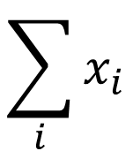






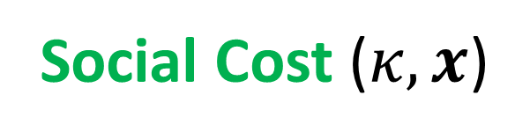



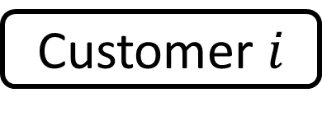
Demand Response for a single timeslot
Social Cost ($κ,x$)
Aggregate
mismatch
Customer
mismatch
Uncertainties
Cost
LSE
$$\sum_{i}{x_{i}}$$
$$D$$
$$C_{g}(∙)$$
$$x_{1}$$
Customer 1
$$C_{1}\left(x_{1}\right)$$
$$δ_{1}$$
Capacity
$$κ$$
$$x_{2}$$
Customer 2
$$C_{2}\left(x_{2}\right)$$
$$δ_{2}$$
$$x_{i}$$
Customer $i$
$$C_{i}\left(x_{i}\right)$$
$$δ_{i}$$
Demand Reductions

Slide 10






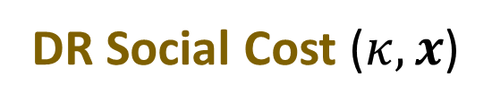


DR and Capacity Planning
Minimize Social Cost
$$κ,x$$
Time 0
Time 1,2,…
Capacity
DR Social Cost ($κ,x$)
LSE
$$κ$$
$$C_{cap}(κ)$$
$$𝔼_{D,δ,C(∙)}\left[DR Social Cost (κ,x)\right]$$
DR program
Aggregate mismatch
Customer mismatch
Customer cost
$$D$$
$$x$$
$$δ_{i}$$
$$x\left(D,δ,C(∙)\right)$$
$$C_{i}\left(∙\right)$$

Slide 11

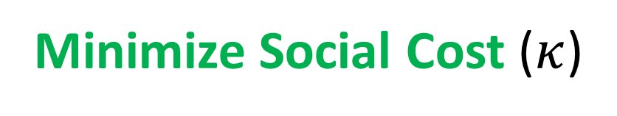
Real-time Optimal
Minimize Social Cost ($κ$)
$$x$$
Aggregate
mismatch
Customer
mismatch
Known
Cost
LSE
$$\sum_{i}{x_{i}}$$
$$D$$
$$C_{g}(∙)$$
$$x_{1}$$
Customer 1
$$C_{1}\left(x_{1}\right)$$
$$δ_{1}$$
Capacity
$$κ$$
$$x_{2}$$
Customer 2
$$C_{2}\left(x_{2}\right)$$
$$δ_{2}$$
$$x_{i}$$
Customer $i$
$$C_{i}\left(x_{i}\right)$$
$$δ_{i}$$
Demand Reductions

Slide 12
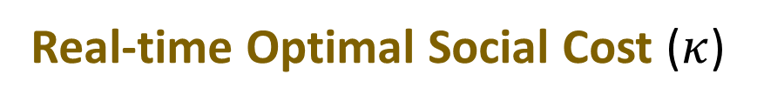

Long-term Optimal
Minimize Social Cost
$$κ$$
Time 0
Time 1,2,…
Capacity
Real-time Optimal Social Cost ($κ$)
LSE
$$κ$$
$$C_{cap}(κ)$$
$$𝔼_{D,δ,C(∙)}\left[Real−time Optimal Social Cost (κ)\right]$$
Aggregate mismatch
Customer mismatch
Customer cost
$$D$$
$$δ_{i}$$
Offline Optimal
$$C_{i}\left(∙\right)$$

Slide 13




DR Program Design
Aggregate mismatch
Customer mismatch
Customer cost
$$D$$
DR program
$$δ_{i}$$
$$x\left(D,δ,C(∙)\right)$$
$$C_{i}\left(∙\right)$$
Goal: Lower Social Cost towards Offline Optimal

Slide 14





Linear contract
Load Reduction
Aggregate mismatch
Individual mismatch
Constant reduction
=
+
+
$$x_{i}\left(D,δ_{i}\right)$$
=
$$α_{i}D$$
+
$$β_{i}δ_{i}$$
+
$$γ_{i}$$
Simple and easy to implement
Within 10% Offline Optimal solution
Real-time Optimal: Quadratic cost functions
Notes:
Give physical meaning and intuitions

Slide 15
Customer cost functions raise challenges
Accuracy: LSE does not know their cost functions
Privacy: Customers do not want to give up their information
→ Separate the DR decision problem

Slide 16
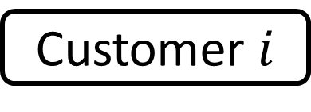
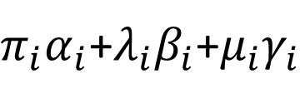
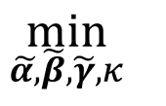
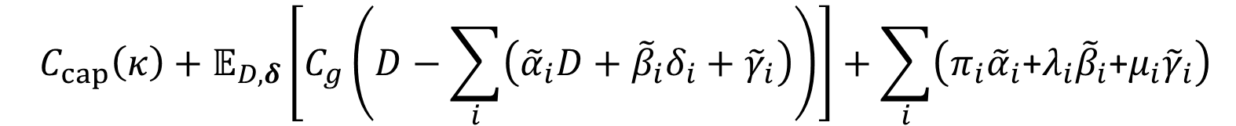


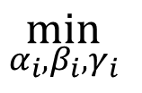
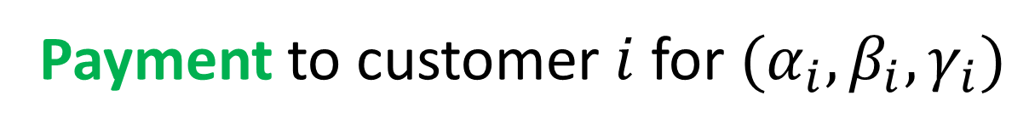
Separating the DR decisions
Prices
Payment to customer $i$ for $(α_{i},β_{i},γ_{i})$
$$\left(π_{i},λ_{i},μ_{i}\right)$$
$π_{i}α_{i}$+$λ_{i}β_{i}$+$μ_{i}γ_{i}$
$${C_{cap}\left(κ\right)+𝔼_{D,δ}\left[C_{g}\left(D−\sum_{i}{\left({\tilde{α}}_{i}D+{\tilde{β}}_{i}δ_{i}+{\tilde{γ}}_{i}\right)}\right)\right]+\sum_{i}{\left(π_{i}{\tilde{α}}_{i}\text{+}λ_{i}{\tilde{β}}_{i}\text{+}μ_{i}{\tilde{γ}}_{i}\right)}}$$
LSE
$$\min_{\tilde{α,}\tilde{β},\tilde{γ},κ}{ }$$
$$\left(π_{i},λ_{i},μ_{i}\right)$$
Customer $i$
$$\min_{α_{i},β_{i},γ_{i}}{ }$$
$${𝔼_{D,δ_{i}}\left[{\hat{C}}_{i}\left(α_{i}D+β_{i}δ_{i}+γ_{i}\right)\right]−\left(π_{i}α_{i}\text{+}λ_{i}β_{i}\text{+}μ_{i}γ_{i}\right)}$$
Notes:
Price for absorbing $α_{i}$ fraction of aggregate mismatch
Price for absorbing $β_{i}$ fraction of own local mismatch
Price for constant reduction $γ_{i}$

Slide 17

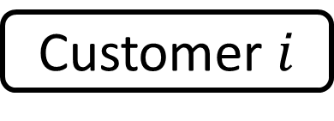






Distributed Algorithm
$$(π,λ,μ)$$
LSE
$$(α_{1},β_{1},γ_{1})$$
Customer 1
$$\left(π_{1},λ_{1},μ_{1}\right)$$
$$(α_{2},β_{2},γ_{2})$$
Customer 2
$$\left(π_{2},λ_{2},μ_{2}\right)$$
Subgradient Method
$$(α_{i},β_{i},γ_{i})$$
Customer $i$
$$\left(π_{i},λ_{i},μ_{i}\right)$$
Notes:
Price for absorbing $α_{i}$ fraction of aggregate mismatch
Price for absorbing $β_{i}$ fraction of own local mismatch
Price for constant reduction $γ_{i}$

Slide 18
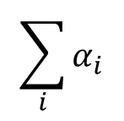




Distributed Algorithm converges to Centralized
Theorem: The distributed algorithm’s trajectory of prices converges to the optimal centralized prices.
0.004
$$α_{1}$$
Customer 1
1
0.002
5000
Dist
Cent
$$\sum_{i}{α_{i}}$$
0.8
4000
0
2
4
6
8
10
0.6
0.004
3000
$$α_{2}$$
Annual Social Cost ($)
Customer 2
2000
0.4
0.002
CUST
1000
0.2
LSE
0
Cent
2
4
6
8
10
0
0
0.004
2
4
6
8
10
2
4
6
8
10
$$α_{3}$$
iteration, k
iteration, k
0.002
Customer 3
0
2
4
6
8
10
iteration, k
( remain at 0 for centralized and distributed solutions)
$$β_{i},γ_{i}$$
Notes:
Our numerical simulation results confirm the theorem.
Sum of alpha’s less than 1 because it takes into consideration customers’ costs.

Slide 19
Linear contracts are robust to supply uncertainty
1.2
1.2
1
1
0.8
0.8
Social Cost
Demand Response
0.6
0.6
0.4
0.4
0.2
0.2
0
60
0
60
80
0
20
40
80
100
120
0
20
40
100
120
Wind Capacity (kW)
Wind Capacity (kW)
Within 10% of Offline Optimal
Notes:
Intuition: As the Aggregate Mismatch gets larger, it gets more expensive for the LSE to handle it. Therefore, it offers a larger price for alpha so that the customers absorb more of the supply uncertainty.

Slide 20

Linear contract drawback: It is mandatory.
1.2
2
1
1.5
0.8
Demand Response
Social Cost
0.6
1
0.4
0.5
Required compliance during high customer cost periods
0.2
0.1
0.2
0.3
0.4
0.1
0.2
0.3
0.4
Customer cost uncertainty
Customer cost uncertainty
$$C_{i}\left(x_{i}\right)$$
Ex. Important tasks that need to be completed
Customer cost
time

Slide 21
Goal: Increase reliable DR adoption
Approach: Incorporate Customer Uncertainties
Distributed Algorithm
Leverage Randomness
Notes:
FCDR will optimize the Level of Commitment.

Slide 22

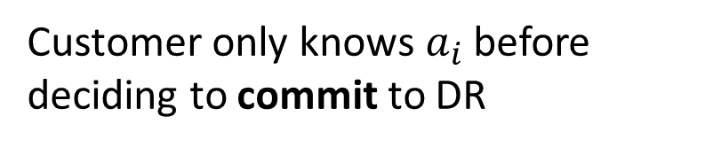
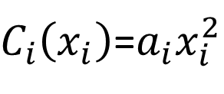
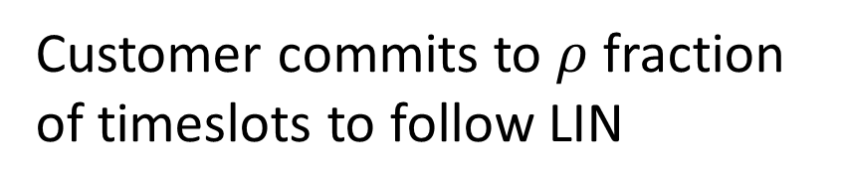
Aim to avoid high customer cost periods
Level of Commitment
0
LIN+( )
1
$$ρ$$
Customer commits to $ρ$ fraction of timeslots to follow LIN
LIN
Commitment decision based only on realized cost function
Ex. Quadratic
$C_{i}\left(x_{i}\right)$=$a_{i}x_{i}^{2}$
Customer only knows$a_{i}$ before deciding to commit to DR
Notes:
→Avoid $(1−ρ)$ of highest cost timeslots.

Slide 23
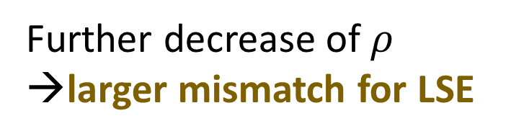
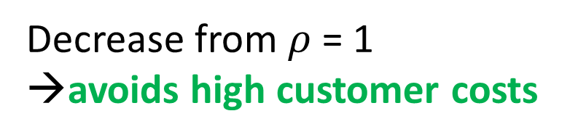
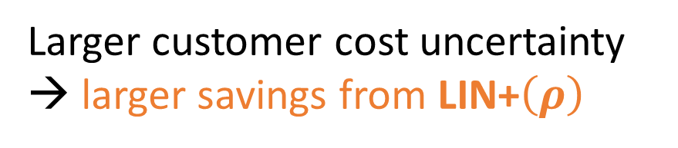


LIN+$\left(ρ\right)$ reduces cost further than LIN only
$$C_{i}\left(x_{i}(t);t\right)=a_{i}(t){\left(x_{i}(t)\right)}^{2}$$
2900
RSD(a) = 0.05
2800
RSD(a) = 0.56
Decrease from $ρ$ = 1
→avoids high customer costs
2700
Annual Social Cost ($)
Further decrease of $ρ$ →larger mismatch for LSE
2600
2500
2400
Larger customer cost uncertainty
→ larger savings from LIN+$\left(ρ\right)$
2300
0
0.2
0.4
0.6
0.8
1
$$ρ$$
LIN
Level of Commitment

Slide 24
Goal: Increase reliable DR adoption
Approach: Incorporate Customer Uncertainties
Converges to centralized solution
Lower Social Cost closer to Offline Optimal
Distributed Algorithm
Leverage Randomness
Notes:
FCDR will optimize the Level of Commitment.

Slide 25
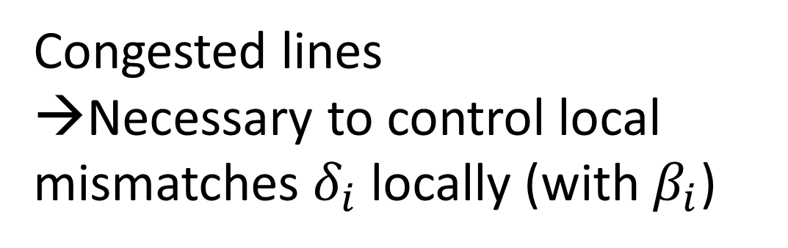
Future work:
Incorporate power network constraints
Ex. Line constraints
Congested lines
→Necessary to control local mismatches $δ_{i}$ locally (with $β_{i}$)
Notes:
Challenge comes from complexity for the combination of which lines are congested.

Slide 26
Harnessing Flexible and Reliable Demand Response Under Customer Uncertainties
Joshua Comden, Zhenhua Liu, Yue Zhao
Stony Brook University
Thank you!
ACM eEnergy 2017

